Slide 1
Leverage the Microsoft Graph & 3rd Party APIs
Calling Azure AD Protected 3rd Party REST APIs

Slide 2

Calling Azure AD Protected 3rd Party REST APIs
Azure AD Protected Resources & SPFx: How it Works
Permission Requests
SPFx’s AadHttpClient
Notes:
In this unit, you'll learn how to use the SharePoint Framework API to call REST APIs that are secured with Azure AD.

Slide 3
Securing REST APIs with Azure AD
Resources in Azure can be easily secured with Azure AD
Requires a request to include a valid OAuth access token in the HTTP header on request
Similar to how existing services are secured
SharePoint REST API
Microsoft Graph API
Azure Management REST API
etc.
Notes:
Resources in Microsoft Azure can be secured with Azure AD. Azure AD can be used to secure REST APIs that are hosted in Microsoft Azure and API hosted in other cloud platforms. Microsoft Azure hosted resources are usually easier to secure as the Azure Management Portal provides a simplified configuration experience.
Azure AD secured REST APIs require all requests to be authorized. To authorize a request, you'll include an OAuth 2.0 access token in the `authorization` HTTP request header. This access token must be obtained from Azure AD using one of the supported OAuth flows.
All available Microsoft REST APIs that don't support anonymous requests are secured with Azure AD. This includes APIs including the SharePoint REST API, Microsoft Graph, Azure Management REST API and many more.

Slide 4
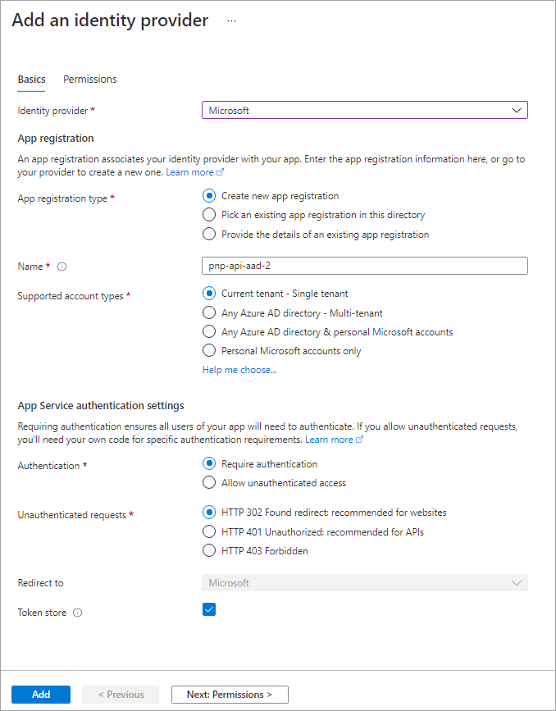
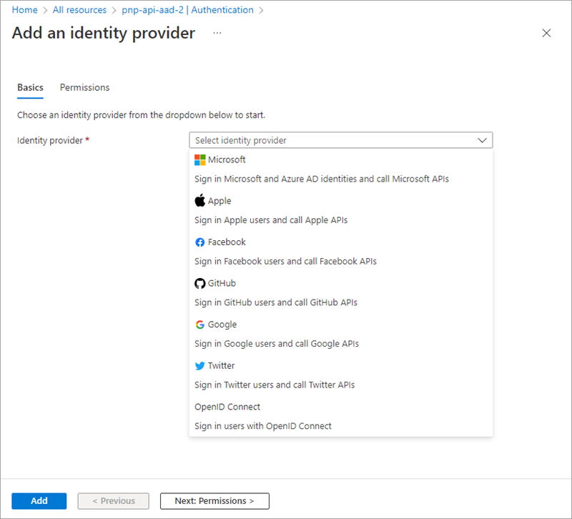
Securing Azure Functions
Notes:
A common approach to implementing a REST API is to use Azure Functions. Securing an Azure Function with Azure AD is simple. In the left-hand navigation, select the **Authentication** menu item.
The **Authentication** blade supports authentication using different OAuth 2.0 providers, including Microsoft, Facebook, Google, and Twitter. After selecting **Microsoft**, you'll then either create a new Azure AD app or associate the Azure Function app with an existing Azure AD app.
By enabling Azure AD authentication on an Azure Function, Microsoft Azure will automatically check for a valid access token in the `authorization` HTTP request header in every request received. If the access token isn't present or not valid, the request is rejected. This verification check is done without you having to write any special code in your Azure Function.

Slide 5
Calling Azure AD Secured Resources from SPFx
Permission requests to resources are granted to special SharePoint app by tenant admin
SharePoint Online Client Extensibility Web Application Principal
Present in each SharePoint Online tenant
Permissions are unique to the tenant, not the SPFx solution
Once a permission is granted, all solutions can leverage the grant
Permission grant is valid until revoked
Permission grant not directly linked to the solution that requested it
Solution installation not linked to permission grant approval / rejection
Notes:
Let's look at how requests to Azure AD secured resources are handled by the SharePoint Framework.
Permission requests to REST APIs, also known as *resources*, are granted to a Azure AD app provisioned in every SharePoint Online tenant: **SharePoint Online Client Extensibility Web Application Principal**.
When you grant a permission request for a specific resource, such as Microsoft Graph, to the **SharePoint Online Client Extensibility Web Application Principal** app, you are granting that entire SharePoint Online tenant the permission. Its important to understand that this permission grant isn't unique to the site or to the SharePoint Framework component; the permission grant applies to the *entire SharePoint Online tenant*.

Slide 6
Granting Permissions to SharePoint Online
Special SharePoint Online Azure AD app can be granted permissions to resources in multiple ways:
Defined within solution manifest – admin notified upon deployment to approve/reject
PowerShell
Office 365 CLI
Ref: https://docs.microsoft.com/sharepoint/dev/spfx/use-aadhttpclient
Notes:
There are three ways you can request and grant permissions to a SharePoint Online tenant:
- **Defined with the SharePoint Framework package solution manifest**: In this option, you'll define the permission requests for the resources that your solution needs in order to run. When the solution is deployed to the App Catalog site, the administrator is notified that they will need to approve or reject the permission request.
- **PowerShell**: PowerShell can be used to submit a permission request, and approve or reject permission requests. You can also use PowerShell to create the permission grant, bypassing the request process.
- **Office 365 CLI**: You can also use the cross-platform Office 365 CLI to request, approve, reject, grant and revoke permission requests the same way you can with PowerShell.

Slide 7
SPFx Solutions Declare Permission Requests
// package-solution.json
{
"$schema": "https://developer.microsoft.com/json-schemas/spfx-build/package-solution.schema.json",
"solution": {
"name": "sp-fx-aad-http-client-side-solution",
"id": "dfb230b7-4f61-431f-9b65-a34e83922663",
"version": "1.0.0.0",
"includeClientSideAssets": true,
"isDomainIsolated": false,
"webApiPermissionRequests": [
{ "resource": "Microsoft Graph", "scope": "User.ReadBasic.All” }
]
},
"paths": {
"zippedPackage": "solution/sp-fx-aad-http.sppkg"
}
}
Notes:
To request a permission when a SharePoint Framework package is deployed to the App Catalog, add it to the `webApiPermissionRequests` array in the **package-solution.json** configuration file in a project.
Each request must include the name of the REST API (`resource`) and the permission (`scope`) requested:

Slide 8
How It Works: Calling Azure AD Secured REST APIs from SPFx
Notes:
After SharePoint Framework package has been added to the App Catalog, let's look the process for granting permissions and how the SharePoint Framework ultimately submits requests to the Azure AD secured REST API.
At the bottom of the figure above, the tenant administrator grants the permissions (also known as *scopes*), to the SharePoint Online tenant. This is done from the API Management page in the SharePoint Admin Center.
Once the permission request is granted, the SharePoint Framework component will ask SharePoint Online for an access token for the specified resource. The SharePoint Online, in conjunction with Azure AD, will validate the permission for the specified resource has been granted to that SharePoint Online tenant and return an access token. The SharePoint Framework will then submit a request to the REST API and include the access token in the `authorization` HTTP request header.
The Azure AD secured resource will verify the `authorization` HTTP request header before passing to the REST API. From this point, the HTTP request continues like normal, processing the request and sending the response back to the SharePoint Framework component.

Slide 9
Using the Azure AD HTTP Client with Promises
import { AadHttpClient, HttpClientResponse } from '@microsoft/sp-http';
this.context.aadHttpClientFactory
.getClient(“https://your-endpoint-uri”)
.then((aadClient: AadHttpClient) => {
const endpoint: string = “https://your-endpoint-uri/api”;
aadClient.get(endpoint, AadHttpClient.configurations.v1)
.then((rawResponse: HttpClientResponse) => {
return rawResponse.json();
})
.then((jsonResponse: any) => {
// work with result
});
});
Notes:
The SharePoint Framework API simplifies the access token acquisition from SharePoint Online and Azure AD. The API uses the token to configure a special instance of the `HttpClient`, known as the `AadHttpClient`, you'll use to submit the request.
To do this, start by importing the `AadHttpClient` object into your TypeScript file:
Next, use the `aadhttpClientFactory` to request an HTTP client configured with the access token for the specified resource:
Finally, use the configured client to call the secured REST API the same way you can use the `HttpClient`:

Slide 10
Using the Azure AD HTTP Client with Async/await
import { AadHttpClient, HttpClientResponse } from '@microsoft/sp-http’;
const aadClient: AadHttpClient = await this.context.aadHttpClientFactory
.getClient('https://your-endpoint-uri’);
const endpoint: string = 'https://your-endpoint-uri/api';
const rawResponse: HttpClientResponse = await aadClient.get(endpoint, AadHttpClient.configurations.v1);
const responseJson = await rawResponse.json();
return responseJson as any;

Slide 11
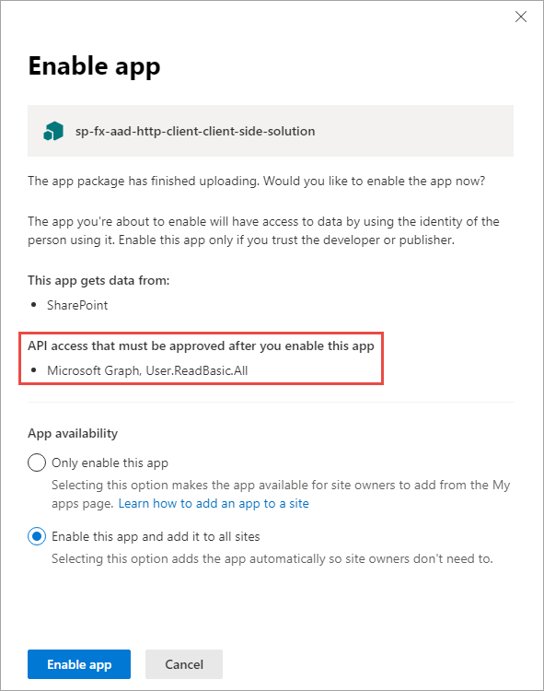
Add SharePoint Package to SharePoint App Catalog
Upload SharePoint packages to the app catalog
Enable app panel contains information about API access (permission) requests
While application can be installed in SharePoint sites, it does not have the permissions granted that it needs to access Azure AD protected resources
Notes:
When an administrator deploys the SharePoint Framework component to the tenant App Catalog, they're presented with information about API access requests in the Enable app panel:
This section of the panel lists the API access requests that should be reviewed and approved or rejected. Recall that API access requests aren't tied to the SharePoint Framework package. Approving or rejecting the API access requests is a separate step that must be done in order for the SharePoint Framework component to work.

Slide 12
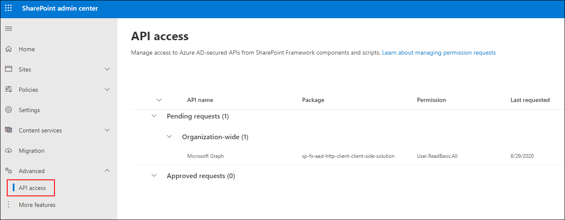
Approve / Reject with SharePoint Online API Management Page
Notes:
To approve or reject API access requests, navigate to the API access page in the SharePoint Admin Center. Here you'll find a list of API access requests pending approval or rejection:

Slide 13
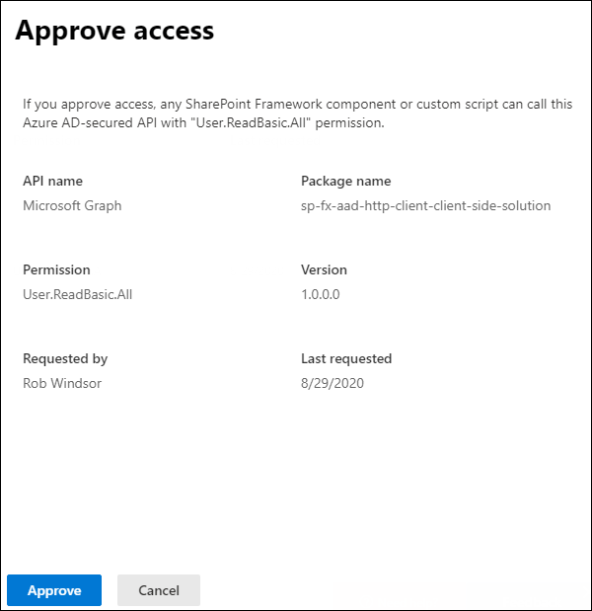
Approve / Reject with SharePoint Online API Management Page
Notes:
Select the API access request to view its details and use the buttons at the bottom of the panel to approve or reject the request:

Slide 14
Demo Calling the Microsoft Graph

Slide 15

Summary
Azure AD Protected Resources & SPFx: How it Works
Permission Requests
SPFx’s AadHttpClient

Slide 16
Reading further
Overview of the SharePoint Framework
https://docs.microsoft.com/sharepoint/dev/spfx/sharepoint-framework-overview
Connect to API Secured with Azure Active Directory
https://docs.microsoft.com/sharepoint/dev/spfx/web-parts/guidance/connect-to-api-secured-with-aad
Connect to Azure AD-secured APIs in SharePoint Framework Solutions
https://docs.microsoft.com/sharepoint/dev/spfx/use-aadhttpclient

Slide 17
Thank you.

